Slide 1

Customer Segmentation Dashboard
Shopping Behaviour Analysis in Istanbul Malls (2021–2023)
Presented By: More Srushti, Jayesh Attarkar, Kashinath Wakude

Slide 2
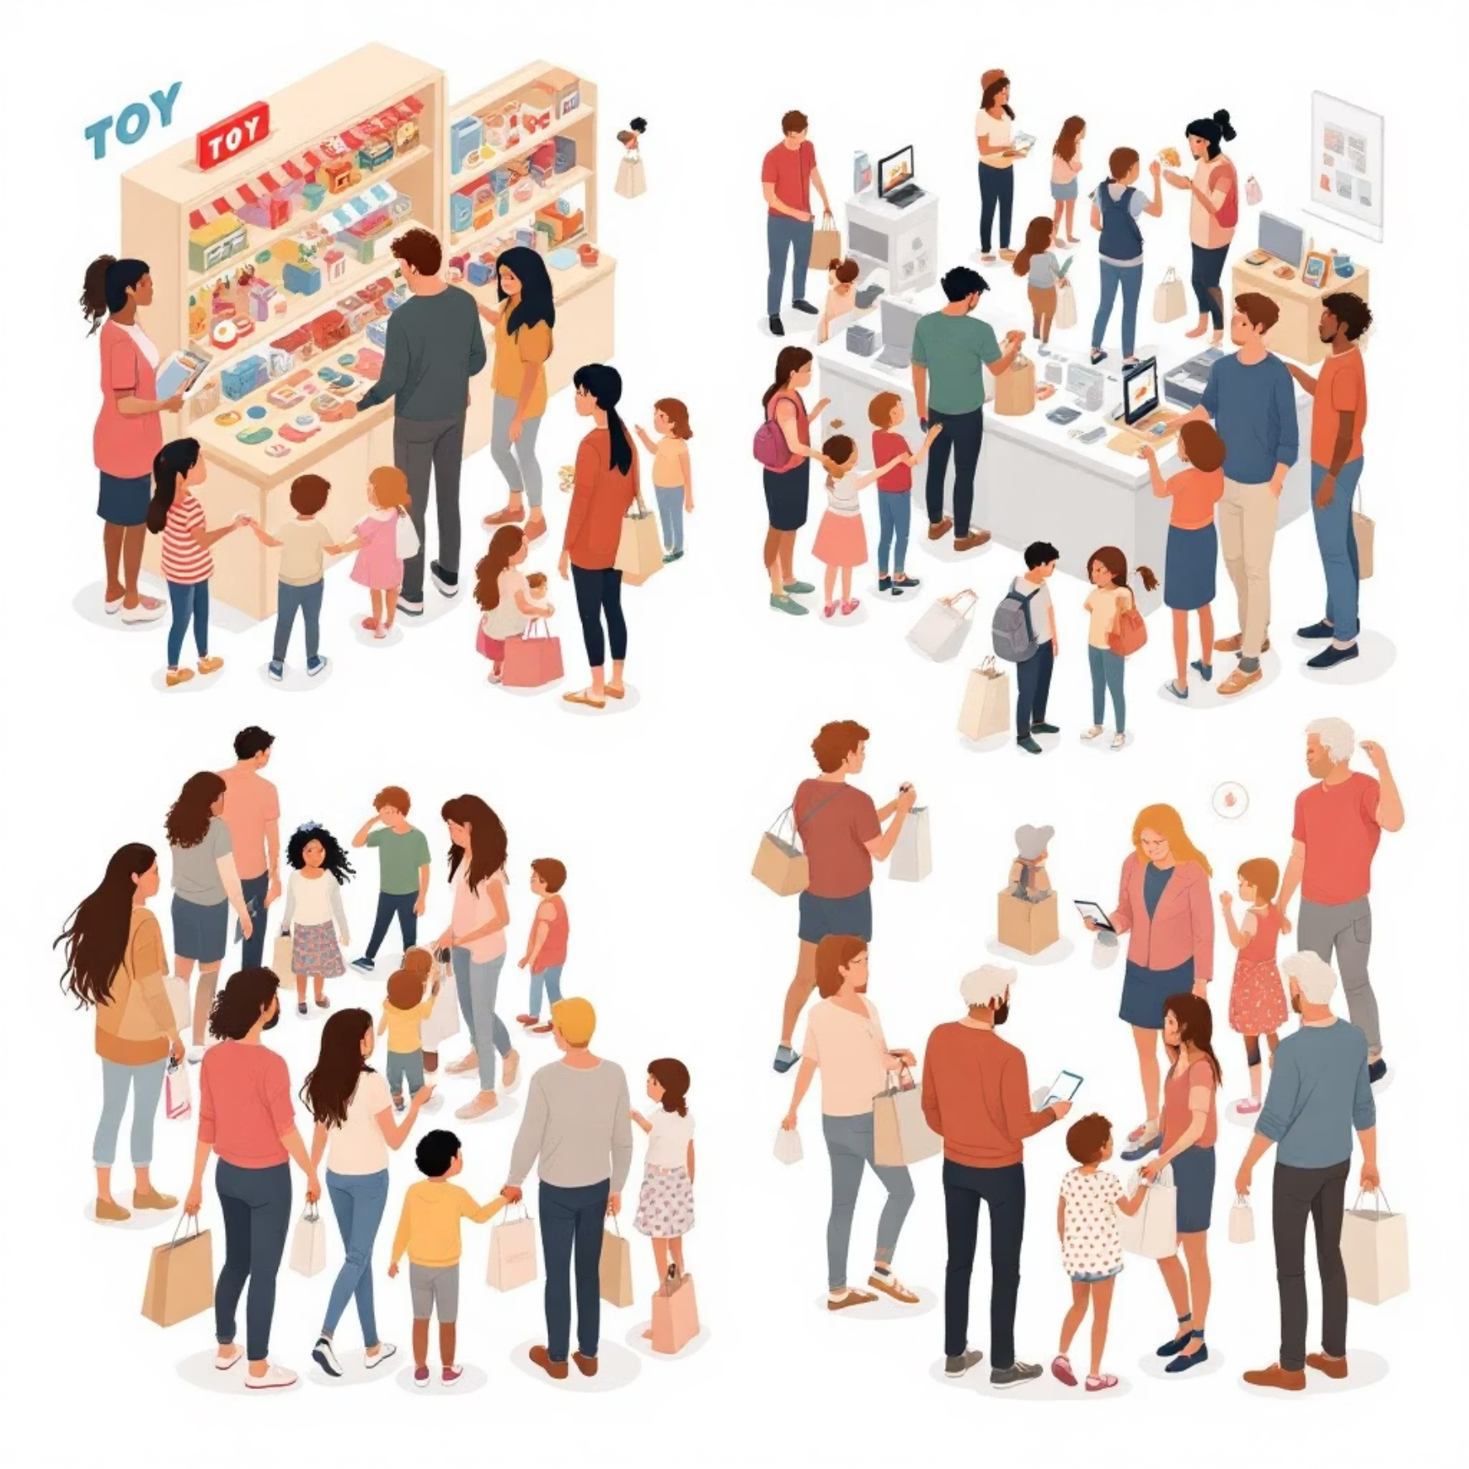
About the Dataset & Project Objective
Dataset Overview
🎯 Project Objective
Our dataset includes extensive customer shopping details from ten prominent Istanbul shopping malls, spanning from 2021 to 2023. It encompasses critical information such as:
To analyse customer shopping patterns and segment them based on demographics, product preferences, and payment behaviour. This will generate actionable insights that support strategic decision-making, enabling targeted marketing and optimised operations.
Customer Demographics: Age and Gender
Purchase Details: Product Category, Quantity, and Price
Transaction Specifics: Payment Method, Transaction Date, and Shopping Mall Location

Slide 3
Dashboard Overview and Key Metrics
1
2
3
Interactive Insights
Visualisation Variety
Key Metrics Tracked
This Power BI dashboard offers a deep dive into customer behaviour, analysing trends across Gender, Age Groups, Product Categories, Payment Methods, and Shopping Mall Locations.
The dashboard incorporates diverse visualisations including bar charts, column charts, donut charts, and dynamic slicers for seamless data exploration and filtering.
We meticulously track critical metrics such as Total Products Sold, Total Revenue Generated, Transaction Counts, and Top Product Categories to provide a comprehensive view of performance.
The dashboard provides a robust framework for understanding and optimising customer engagement and sales strategies within Istanbul's mall ecosystem.

Slide 4
Gender-Based Shopping Analysis
Task 1: Shopping Distribution by Gender
Task 2: Products Sold by Gender
Observation: Female customers recorded a slightly higher number of shopping transactions across all malls, indicating higher engagement.
Observation: The total quantity of products sold to female customers exceeded that to male customers.
Interpretation: Females tend to visit malls more frequently or are more inclined to make purchases, driving overall footfall and transaction volume.
Interpretation: Female shoppers either purchase more items per visit or shop more often, significantly contributing to product movement.
Task 3: Revenue Generation by Gender
Observation: Female customers generated substantially higher total revenue compared to males. This was calculated as Revenue = Quantity × Price per transaction.
Interpretation: This suggests that females either purchase higher-value items or their larger purchase volumes result in greater sales value, making them a more lucrative segment.

Slide 5
Age-Based Shopping Analysis
Task 7: Revenue Generated by Age
Task 6: Product Quantity by Age
Task 5: Transaction Distribution by Age
Observation: The 56–69 age group generated the highest revenue, with 18–25 contributing the least.
Observation: The 56–69 age group also purchased the most products, while 18–25 bought the least.
Observation: The 56–69 age group showed the highest number of transactions, while 18–25 had the lowest.
Interpretation: Older customers are not only shopping more but also spending significantly, positioning them as the most valuable segment for business impact.
Interpretation: Older shoppers tend to make bulk or more frequent purchases, possibly catering to family needs or differing lifestyle choices.
Interpretation: Older customers, possibly with greater financial stability and leisure time, engage in shopping more frequently.
These insights highlight the importance of tailoring marketing and product offerings to cater to the distinct behaviours and purchasing power of different age demographics.

Slide 6
Product Category Preferences: A Deeper Dive
Task 4: Purchase Categories Distribution
Task 8: Age & Payment Method Influence
Overall: Clothing and Food & Beverage were the most purchased categories.
Younger Customers (18–27): Preferred clothing and food & beverage.
Gender-wise: Females preferred clothing and cosmetics; males leaned towards electronics and home appliances.
Older Customers (56–69): Also favoured clothing and food & beverage, showing consistent preferences across age extremes.
Location-wise: Preferences varied by mall, suggesting demographic and store-specific influences.
Credit Card Users: Spent more on clothing and food & beverage.
Cash: Most common payment method across segments.
Debit Cards: Least used across all groups.
These findings are crucial for inventory planning, targeted advertising, and optimising payment partnerships to align with customer behaviour.

Slide 7
Payment Method Analysis
Task 9: Payment Method Relation with Other Columns
Task 10: Overall Payment Method Distribution
Across Age Groups (18–55): Cash is the most commonly used, with debit card usage being minimal. Credit cards are secondary to cash.
Overall: Cash is the most frequent payment method, followed by credit cards, with debit cards being the least used.
Interpretation: Customers consistently prefer cash, possibly due to spending habits, ease of use, or a preference for tangible transactions. Debit card usage remains remarkably low.
Visualisation: A donut chart vividly represents these shares, emphasising cash's dominance. This highlights a clear trend across all demographics.
Businesses could benefit from offering cash-based promotions while ensuring flexible credit options remain available to cater to varied customer preferences.

Slide 8
Leveraging Slicers for Dynamic Analysis
Purpose of Slicers
Slicers Used in Dashboard
Slicers empower users to dynamically filter data, enabling more meaningful pattern analysis and supporting detailed comparative studies. They enhance dashboard interactivity and customisation.
Gender: Filter charts by Male or Female to compare behavioural trends.
Age Group: Analyse shopping patterns across specific age ranges (e.g., 18–25, 26–35, etc.).
Shopping Mall: Examine customer activity and preferences specific to each mall location.
Payment Method: Observe how product and spending trends vary by cash, credit, or debit card.
These slicers significantly enhance the dashboard's utility, making it a powerful tool for uncovering hidden patterns and gaining deeper insights into customer attributes.

Slide 9
Key Findings from the Dashboard
Gender Insights
Age Group Trends
Product Preferences
Female customers drive higher purchases and revenue, showing strong preferences for clothing and cosmetics.
The 56–69 age group is the most active and highest spending, while 18–25 is the least engaged.
Clothing and food & beverage are top categories across most segments, with preferences varying slightly by age and gender.
Payment Behaviour
Mall Influence
Cash is the most common payment method, followed by credit cards; debit card usage is minimal.
Product trends and revenue contribution vary by mall, suggesting localised demographic-based strategies.
Older customers and female shoppers emerge as the most valuable segments, necessitating targeted stocking, promotions, and payment offers.

Slide 10
Summary of Key Insights & Recommendations
Our analysis reveals critical patterns in customer behaviour across Istanbul malls, providing actionable intelligence for business growth.
Key Insights
Recommendations
Female shoppers and the 56–69 age group are top contributors.
Target high-value segments with personalised promotions.
Optimise stock for top categories based on mall demand.
Clothing & Food & Beverage are leading product categories.
Encourage credit card usage via loyalty programs.
Cash is the preferred payment method, followed by credit cards.
Leverage insights for personalised marketing campaigns.
Continuously enhance Power BI dashboard for ongoing analysis.
By implementing these recommendations, businesses can significantly improve customer satisfaction, streamline operations, and boost revenue across all Istanbul malls.

